Slide 1






KONGU ENGINEERING COLLEGE
PERUNDURAI ERODE-638060
COMPUTER TECHNOLOGY-PG
INTRODUCTION TO TAILWIND CSS
22VC003
PROJECT TITLE
MY TOURS
In association with:
SUBMITTED BY:
MAKANESHA V (22ISR023)

Slide 2


INDEX
EXISTING SYSTEM
PROPOSED SYSTEM
MODULES
MODULE DESCRIPTION
CONCLUSION
SNIPPETS OF WORK

Slide 3
EXISTING SYSTEM
The existing tourism website lacks real-time updates on attractions and accommodations, leading to outdated information .
Drawbacks for existing system
• Limited user interactivity hampers engagement, and the absence of personalized recommendations hinders user satisfaction.
• Additionally, the site's navigation is cumbersome, impeding a seamless user experience.

Slide 4
PROPOSED SYSTEM
User-friendly interface for seamless navigation.
Dynamic content showcasing diverse travel destinations.
Personalized user profiles for tailored recommendations.
Integrated booking system for flights, hotels, and activities.
Real-time weather updates and travel advisories.

Slide 5

MODULES
HOME
DESTINATION
CATEGORY
CONTACT
ABOUT
HELP

Slide 6
MY TOURS
MY TOURS a travel website which works on call out formula.
With the customer’s request a guide is sent to all the trips.
This website is launched mainly to visit various places inside india and worldwide.
Our website respects privacy and security
Affordable prices are implemented
If there’s anything to be alerted the toll-free number in the website.

Slide 7
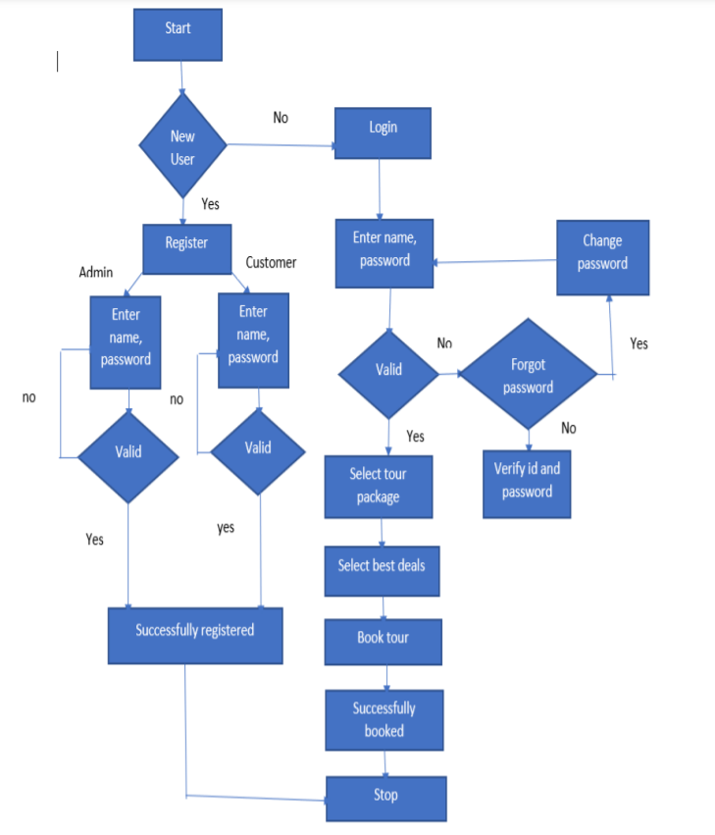
DATA FLOW DIAGRAM

Slide 8
CONCLUSION
This project summarises that the trip involves hidden spots of world..
A best trip is a form away , you can book a trip easily without any tedious process.
A agent would accompany you throughout the trip with the consent of the traveler.

Slide 9
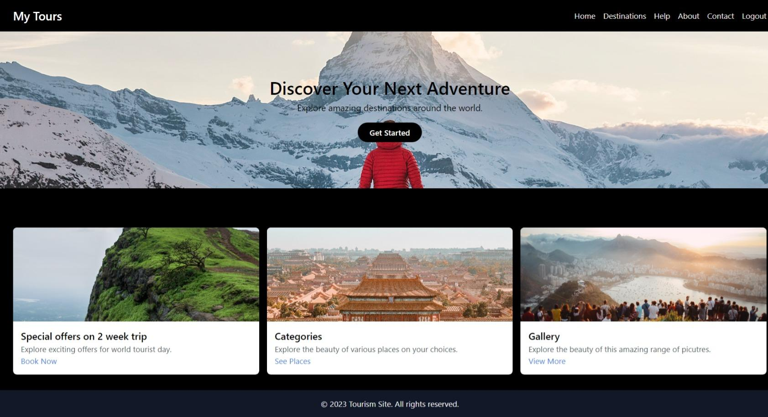

Slide 10
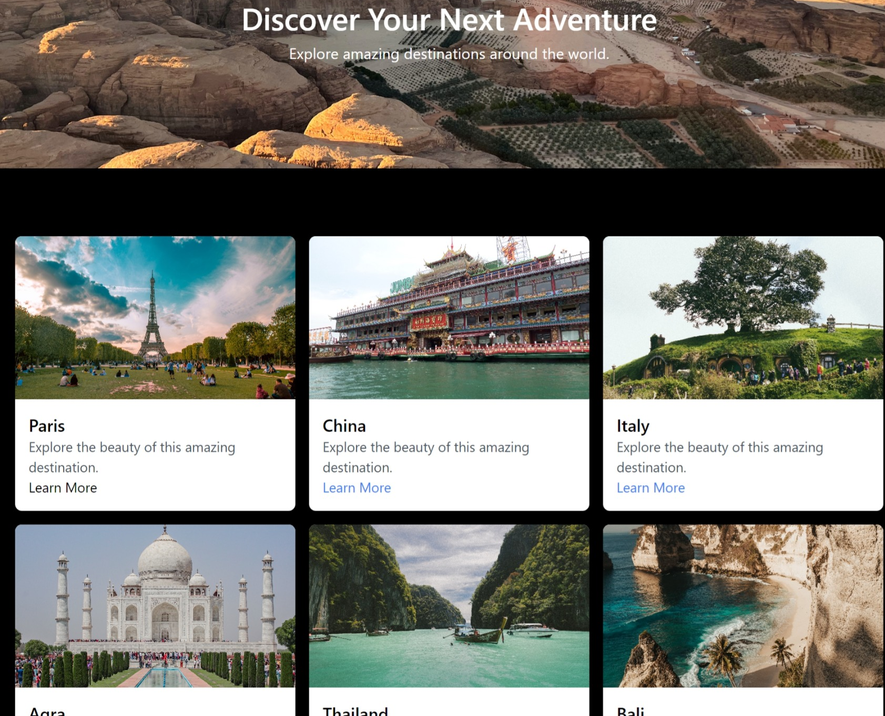

Slide 11
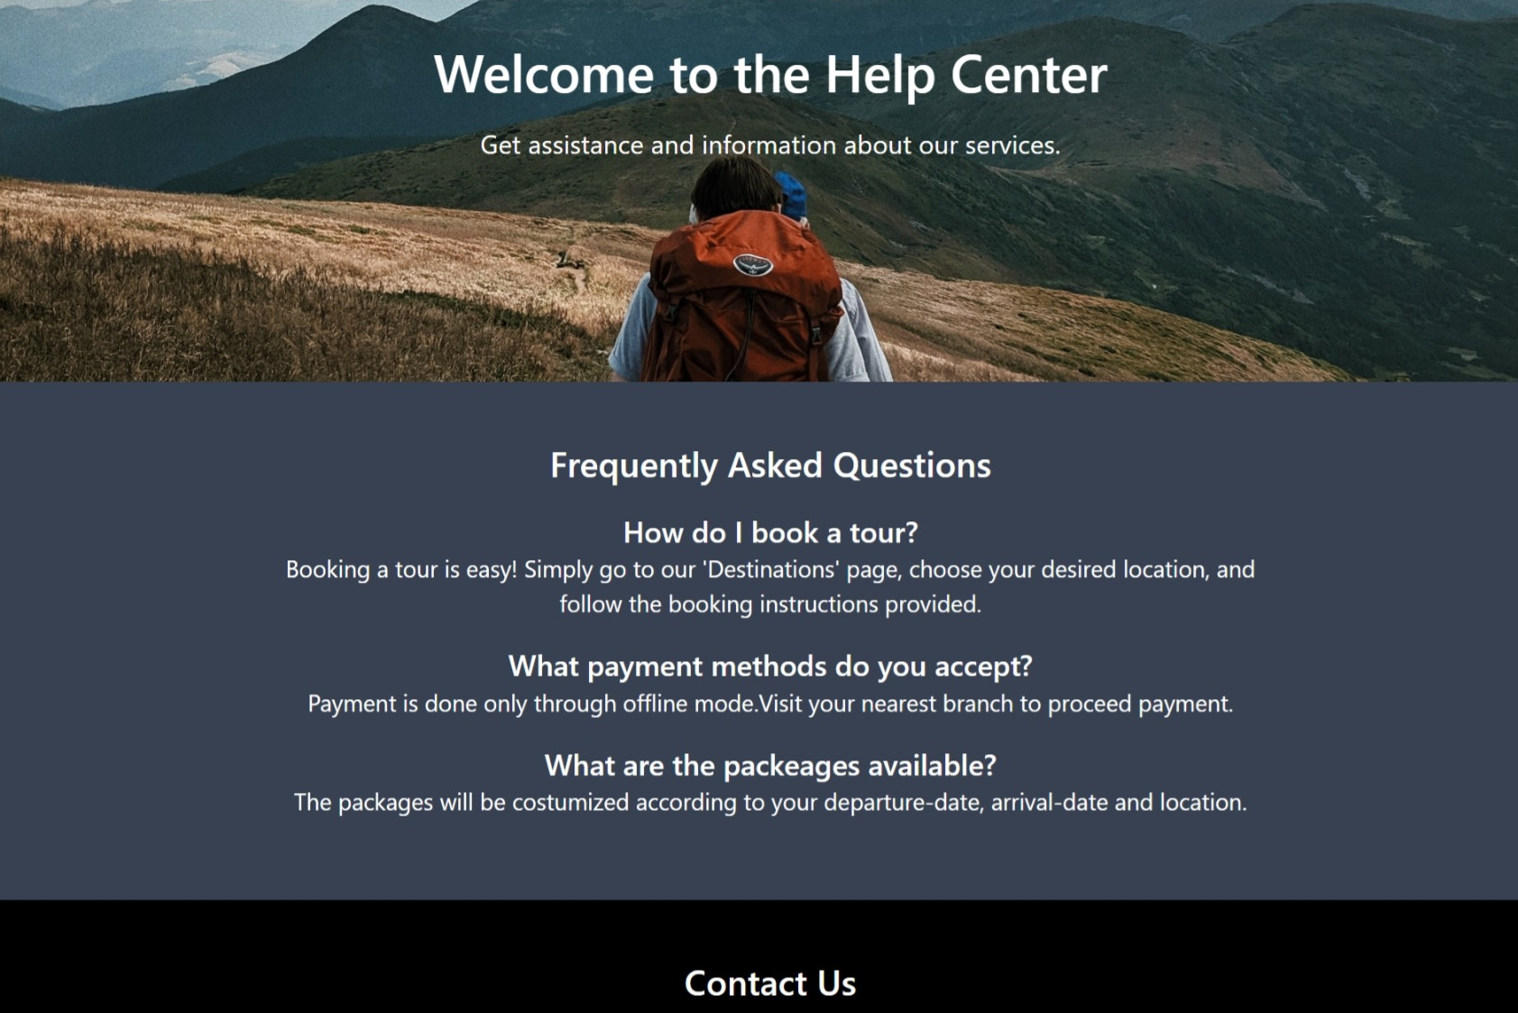

Slide 12
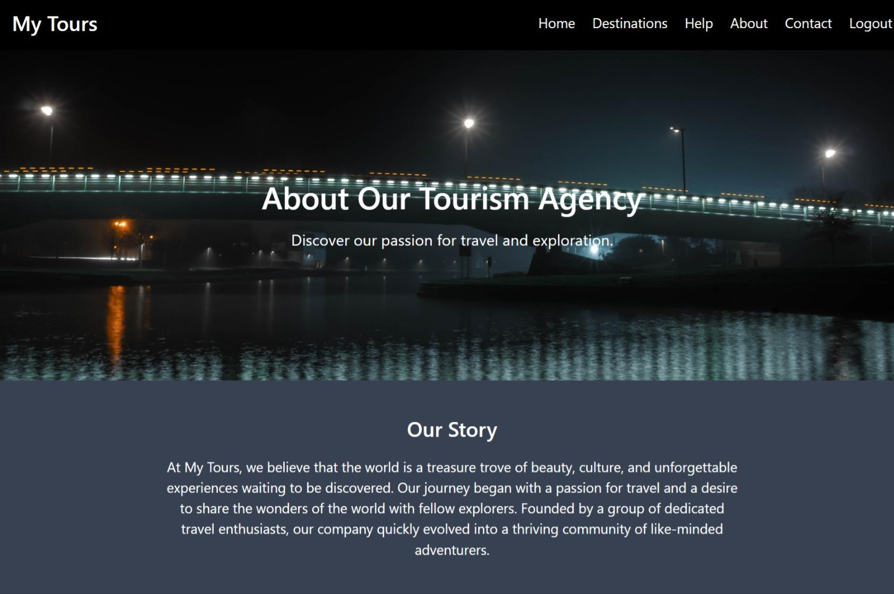

Slide 13
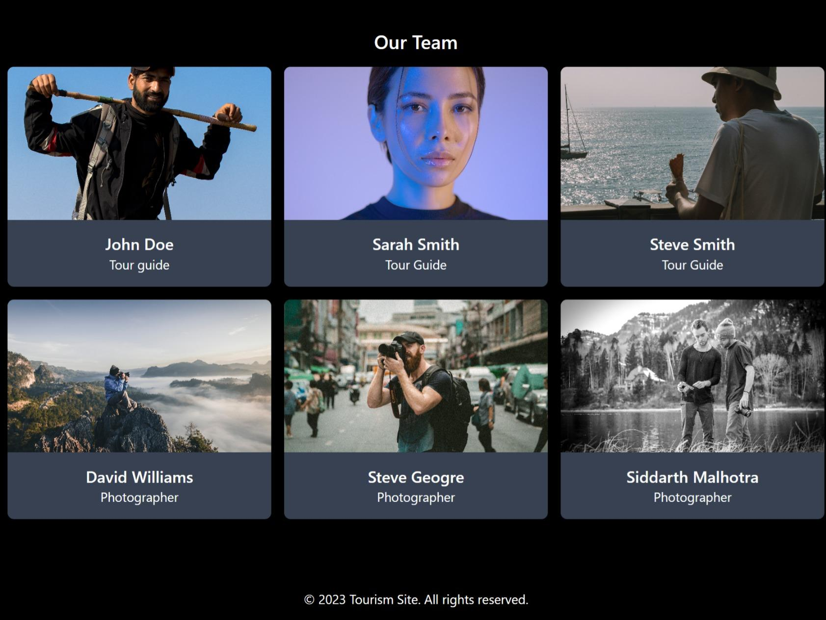

Slide 14
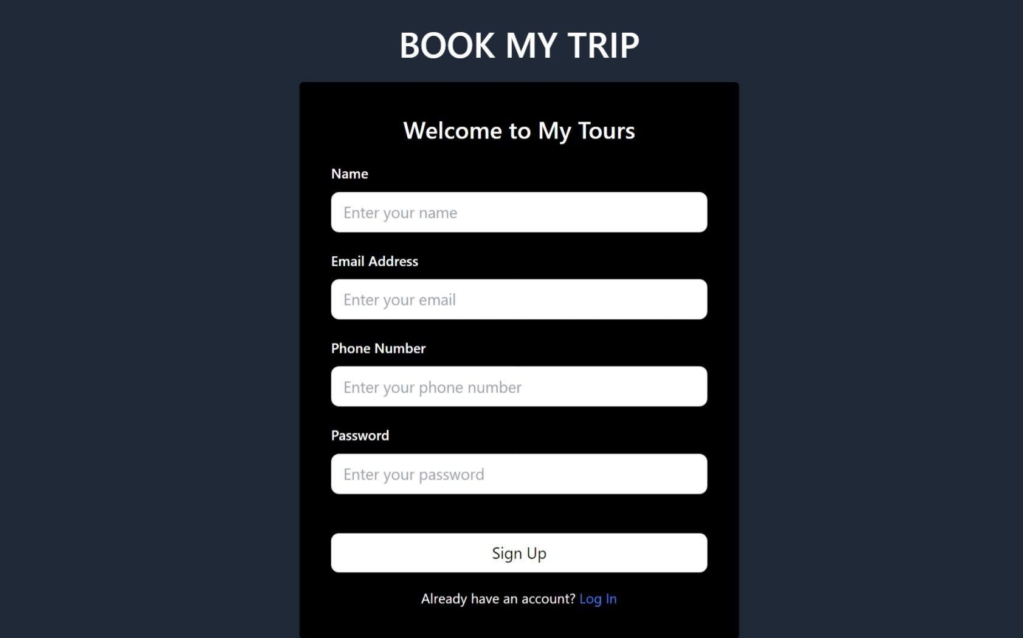

Slide 15
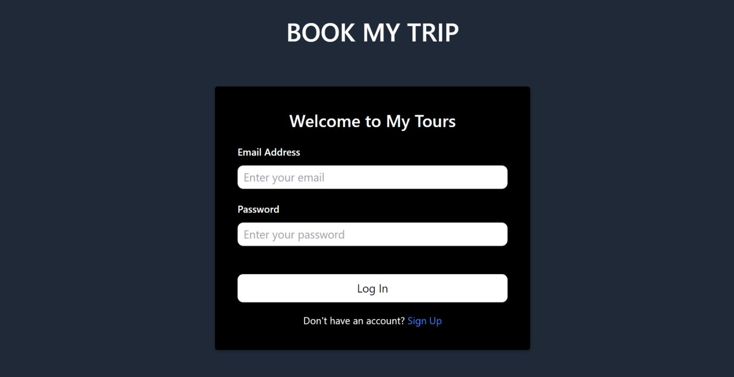

Slide 16
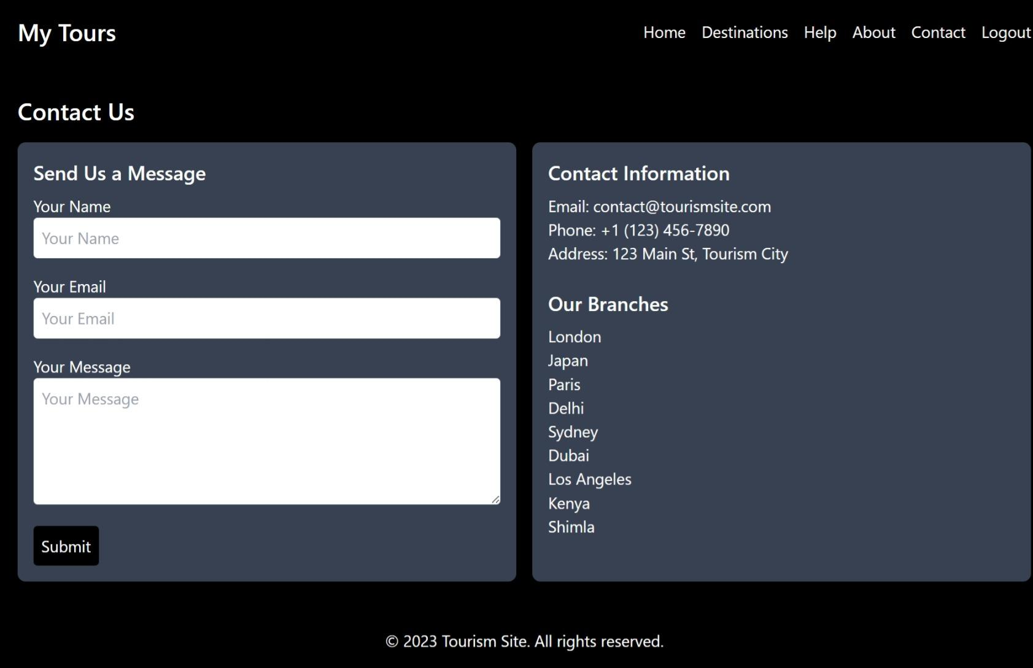

Slide 17
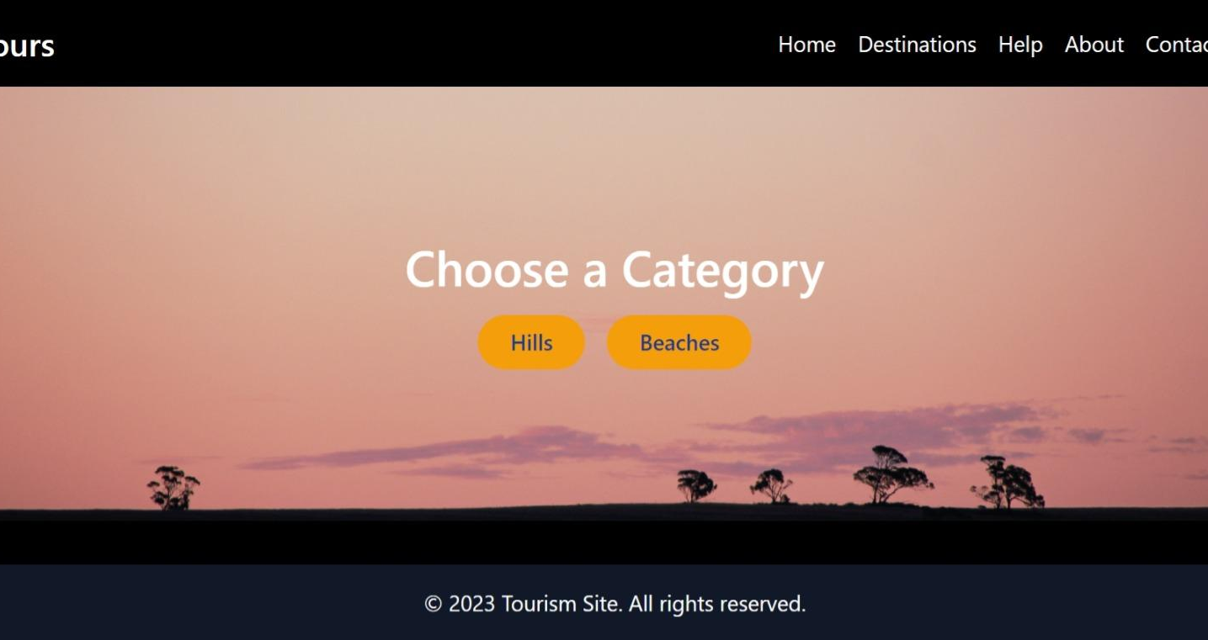

Slide 18
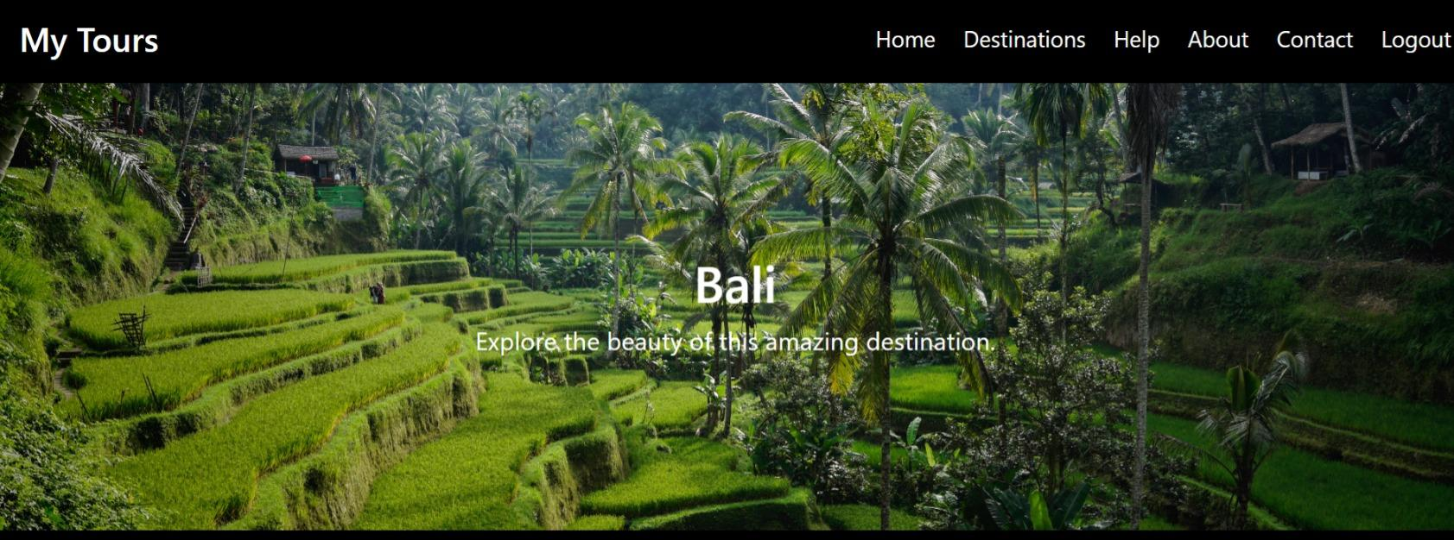

Slide 19
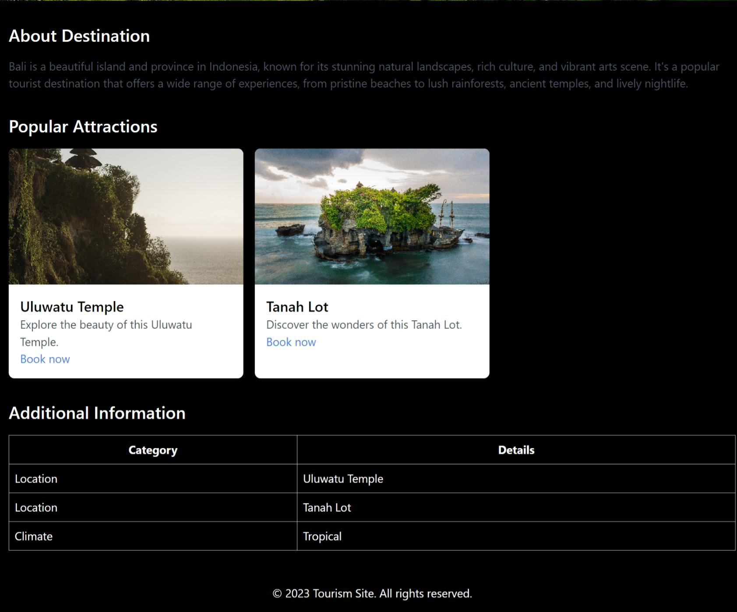

Slide 20
THANK YOU

